Slide 1
…

Slide 2
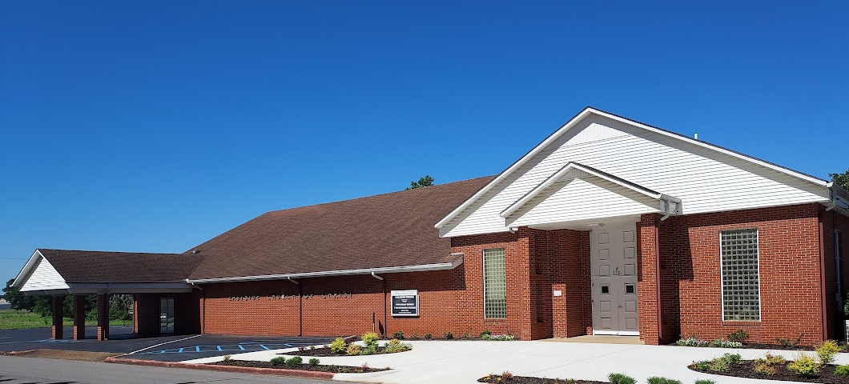

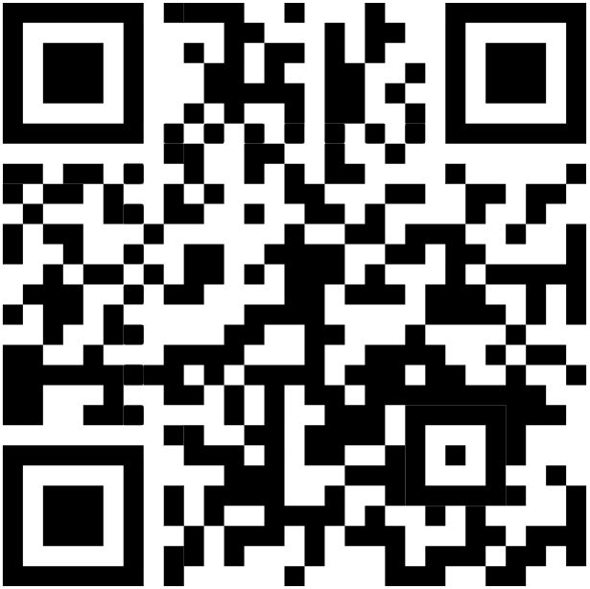
Welcome
Services will begin in:
WELCOME VISITORS
Please scan the QR code to allow us to have a record of your visit
www.eastside-church.com/welcome

Slide 3

Auditorium
The Growth and Development of the New Testament Church
Eastside Curriculum – Qtr 14 (Nov. 2025 – Jan. 2026)

Slide 4
Paul’s Defense Before Felix 24:1-23
Paul speaks to Felix and Drusilla 24:24-27
Festus learns about Paul 25:1-5
Paul appeals to Caesar 25:6-12
King Agrippa and Bernice arrive in Caesarea 25:13-22
Agrippa and Bernice w/other leaders hear Paul 25:23-27
REVIEW

Slide 6
1)
2)
3)
4)
5)
6)
7)
8)
9)
10)
11)
12)
13)
14)
15)
Ascension & Appointment
Philippian Prison
16)
17)
18)
19)
20)
21)
22)
23)
24)
25)
26)
27)
28)
Pentecost & Peter’s Preaching
Addressing Athens
Lame Man & Lesson
Achaia, Antioch, & Apollos
Restrained, Released, & Request
Re-baptism, Repentance, & Riot
Deception & Detention
Macedonia & Miletus
Seven Selected
Jerusalem & Jewish Mob
Stephen Stoned
Review & Rejection
Samaria & Salvation
Council & Conspiracy
Saul Saved & Dorcas Delivered
Caesarean Confinement
Cornelius Converted
Appeal & Agrippa
Report & Relief
A
Review & Ridicule
Persecution, Peter, & Pride
Marooned On Malta
CTS
Antioch to Iconium
F
Rescued To Rome
Iconium to Antioch
ACTS
Disagreement & Decision
Alliteration Memory Statements To Help Recall Chapter Content
Notes:
Reference the Alliteration memory statements available for individual study of Acts and a means of helping each of us better study the book of Acts

